Slide 1
Presentation on Sarah Bagley
By Peggy Lee

Slide 2
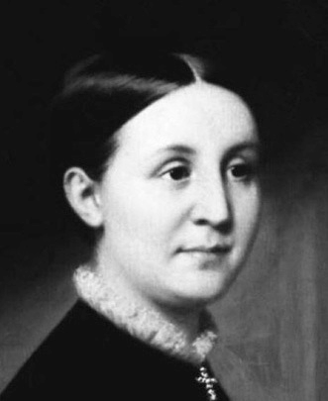
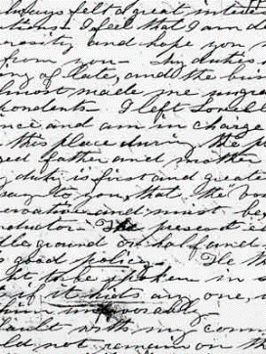
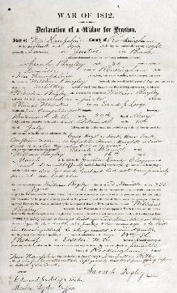
Images of Sarah and her letters

Slide 3



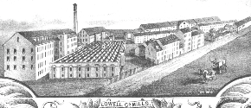
Background and life
Sarah fought for women’s and workers’ rights in the 1840s
She born on April 19, 1806 in Canada.
At the age of 31, she moved to Lowell, MA.
She began working at a textile manufacturing industry called Hamilton’s Mill.

Slide 4
Rise of power
In the essay The Pleasures of Factory Work, Bagley criticized the amount of freedom factory girls received. She was later banned from further write-ups.
She founded the Lowell Female Labor Reform Association (LFLRA), which aimed for better working environment and the “ten-hour day”.
In 1844, under her leadership, LFLRA worked with the New England Workingmen’s Association (NEWA).
They published the The Voice of Industry together.
They issued the first petition for the “ten-hour day”, which received 2139 signatures. However, it was declined by the state legislature.

Slide 5
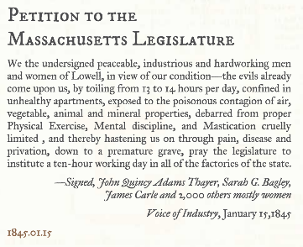
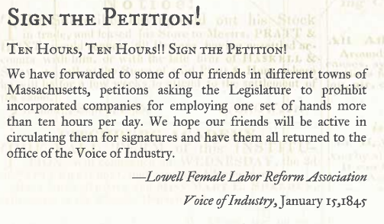
Rise of power

Slide 6
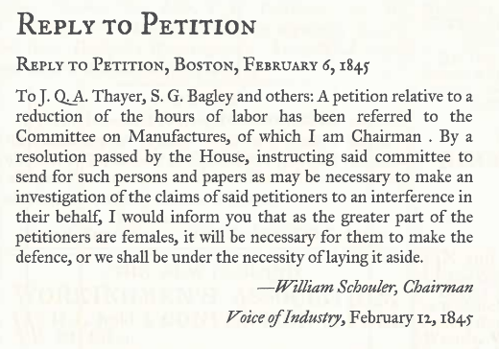
Rise of power

Slide 7
Success
LFLRA went around New England in search of new workers and establishing branches for both itself and NEWA.
Sarah attended multiple conferences regarding the rights of laborers.
She was also one of the participants of the abolitionist movement and served as the voice of the prisoner reformation, together with Dorothea Dix.
LFLRA produced campaigns opposing the idea of doubling labor work with the reduction salary, created classes for laborers to attend, and published booklets explaining the ignorance, misery and health damage caused by mill work.

Slide 8
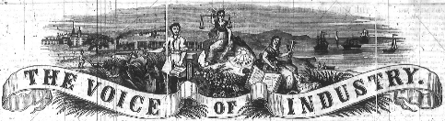
Challenges she faced
A second petition was launched and was rejected.
LFLRA felt that they could not trust Sarah Bagley anymore.
Sarah got into a fight with John Allen, the new editor working for the Voice of Industry. He dismayed women’s position in the publication of newspapers, especially those on labor movements.
After publishing her last piece of article that belonged to The Voice of Industry in the October of 1846, Bagley quitted LFLRA and stopped being a social reformer.

Slide 9
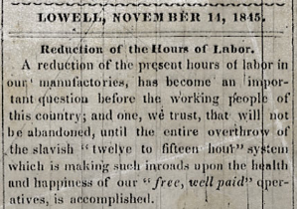
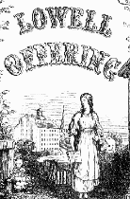
Legacy
Although the ten-hour movement did not succeed at the end, it allowed men and women to collaborate and work as a team.
Her accounts in the Lowell’s Offering and The Voice of Industry allows historians and students today to study about the ranking of women in society and the working conditions for laborers back in the 1800s.

Slide 10
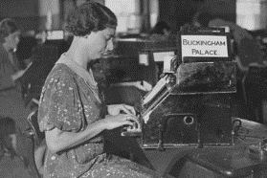
After quitting...
She became the first female telegrapher in the United States.
She provided the service of writing messages and letters. Due to gender discrimination, she earned only two-thirds of the salary her male colleagues earn. She was pissed and left the business.
She left for Philadelphia, where she provided daily needs for prostitutes and disadvantaged young women.

Slide 11

After quitting...
In the same year, she met James Durno.
They married and migrated to a city Albany, NY and worked on the investigation of herbs and medicines.
They became wealthy and opened a medicine manufacturing company. They also lived in a large and luxurious house in Brooklyn Heights.
Sarah Bagley passed away in 1883.

Slide 12
Discussion Question
If you were Sarah Bagley, would you give up on the labor movement? If not, what would you do to express your animosity?

Slide 13
Works Cited
Historical Context – Sarah Bagley and Labor Reform. Rhetoric En Masse. Rhetoric En
Masse, 2010. Web. 7 December 2015.
Lowell Notes. Lowell National Historical Park. Lowell National Historical Park, 2015.
Web. 7 December 2015.
Sarah Bagley. The Pleasures of Factory Life. McDougal Littell Inc. McDougal Littell Inc.,
2015. Web. 7 December 2015.
Sarah Bagley Avenges the New England Mill Girls. New England Historical Society. New
England Historical Society, 2014. Web. 7 December 2015.
Sarah George Bagley. University of Massachusetts Lowell Library. University of
Massachusetts Lowell Library, 2015. Web. 7 December 2015.

